Slide 1



Team Name: Boomers
Team ID: [TEAM 077]
Problem Statement Selected: Smart Hybrid Eco Tree – Renewable Energy & Pollution Monitoring for Urban Spaces
Theme: [Environmental Sustainability Problem Statements]
Sharda University • Bishwash Kumar Panday, Abhay Kumar, Nancy Thakur, Vanshika Rana

Slide 2



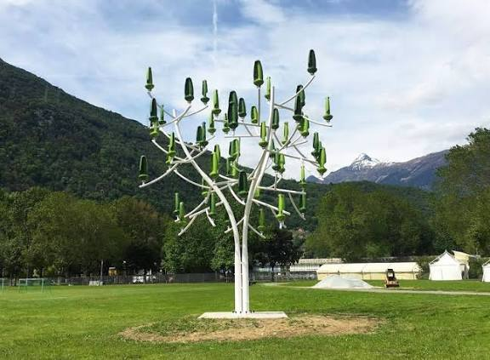





IDEA / SOLUTION TITLE
OUR IDEA
A Tree-Inspired Structure That Generates,
Monitors, and Responds — All In One
Cities face three connected problems: rising energy demand, worsening pollution, and limited usable space. The Smart Hybrid Eco Tree is a single vertical structure that combines solar and wind generation, energy storage, pollution monitoring, and smart control — solving all three together.
Solar Power
Wind Power
Energy Storage
Pollution
Monitoring
Smart
Control
Concept render — hybrid wind + solar tree structure
Generate Energy → Monitor Environment → Respond Automatically

Slide 3


TECHNICAL APPROACH
HOW IT WORKS
Two Integrated Flows, One Unit
The system architecture integrates generation, storage, pollution sensing, and automatic response in a single structure.
POWER GENERATION FLOW
POLLUTION RESPONSE FLOW
1
Solar Panels + Wind Turbine
1
Pollution Sensors
2
Power Conditioning System
2
AI-Based Analysis
3
Battery Storage
3
Pollution Detected
4
Electrical Loads / EV Charging
4
Air Purifier Activated
ADAPTIVE FEATURES
Solar Tracking
Self-Cleaning
Smart Energy Mgmt
IoT Monitoring

Slide 4
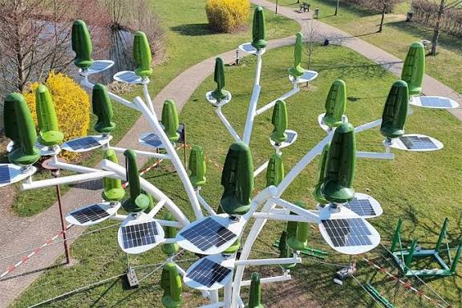
USER EXPERIENCE & DESIGN
DESIGN
Designed to Be Modular
A radial branch layout lets every component be added, replaced, upgraded, or scaled independently — keeping the structure easy to maintain and expand.
Solar Branches
↓
Wind Turbine
↓
Central Control System
↓
Battery Storage
↓
Rainwater Storage
Aerial view — radial branch layout concept
Add → Replace → Upgrade → Scale

Slide 5
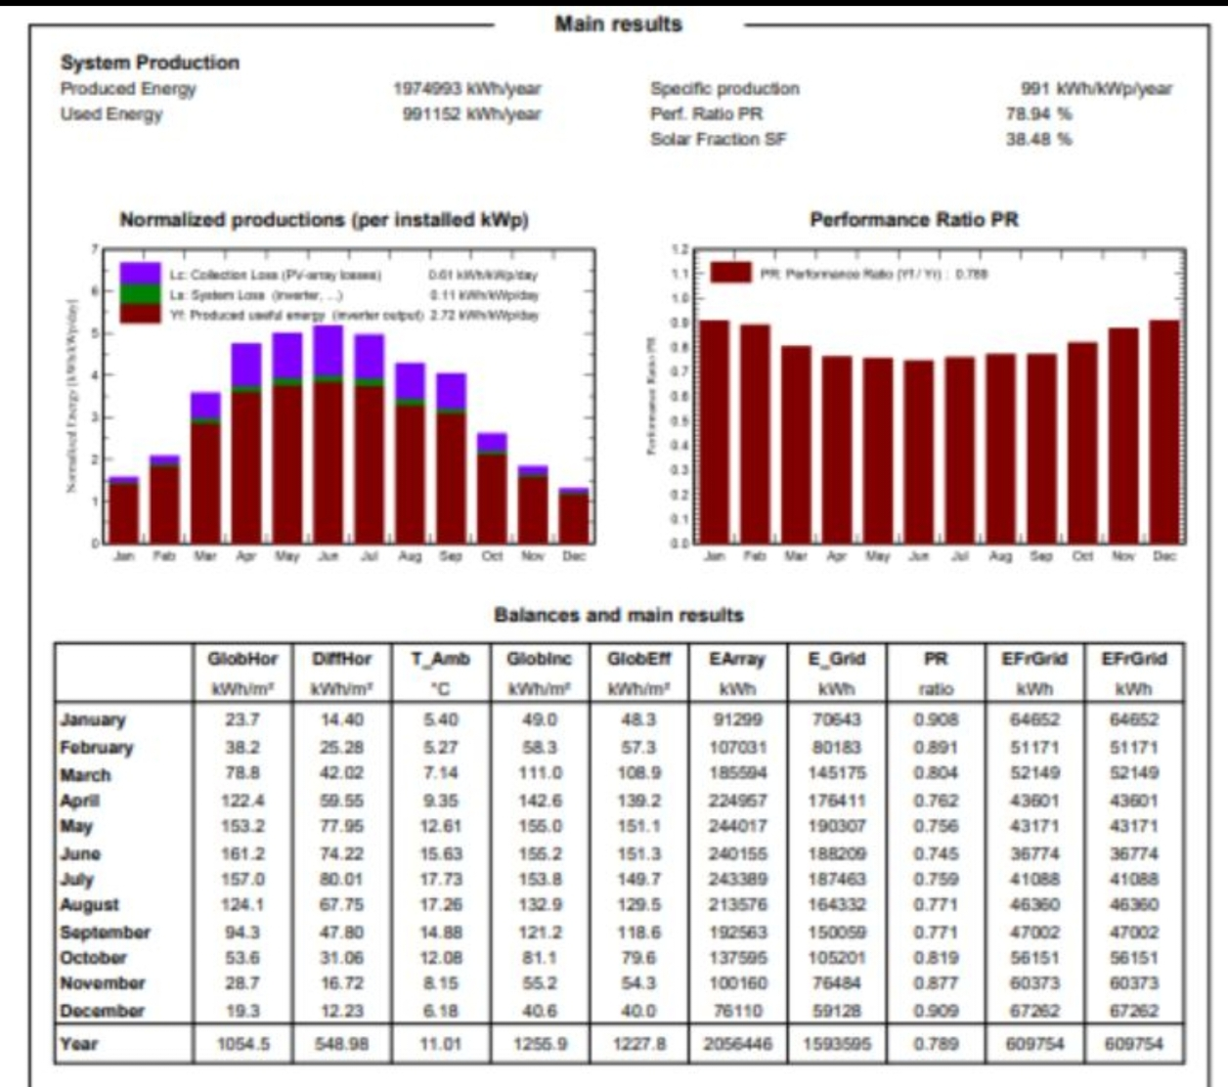


FEASIBILITY AND VIABILITY
FROM CONCEPT TO PROTOTYPE
Validated in Simulation, Ready for Prototyping
Current Development
✓ 3D structural design – complete
✓ Wind-flow analysis – complete
✓ Solar analysis – complete
✓ Power-system analysis – complete
Next Stage
→ Build physical prototype
→ Test individual subsystems
→ Integrate complete system
→ Validate performance
PV-system simulation (PVsyst) — monthly production, performance ratio and solar fraction used to validate the solar branch's expected yield.

Slide 6






IMPACT AND BENEFITS
APPLICATIONS
Designed for Real Urban Environments
Highways
Smart Cities
EV Corridors
Solar generation + vehicle-induced airflow + pollution monitoring.
Decentralized renewable energy + environmental monitoring.
Renewable-assisted energy supply + charging.
Future expansion: campuses, industrial areas, and residential environments.
OUR VISION — TODAY'S URBAN STRUCTURES ARE MOSTLY PASSIVE. WE WANT TO MAKE THEM:
Energy
Producing
Environment
Aware
Intelligent
Adaptable
Scalable

Slide 7





BUSINESS MODEL & SUSTAINABILITY
BUSINESS MODEL & SUSTAINABILITY
A Scalable, Low-Maintenance Path to Deployment
Drawn from the product's modular design and target applications — to be refined with real cost and partnership data.
Deployment Partners
Modular Revenue Units
Low Operating Cost
Municipal bodies, smart-city programs, highway authorities, and EV-infrastructure operators for phased rollouts.
Each branch (solar, wind, sensing) can be sold, leased, or upgraded independently, lowering entry cost.
Self-cleaning panels and remote IoT monitoring reduce manual maintenance and site visits.
SUSTAINABILITY
100% renewable solar + wind generation
Reduces urban emissions via pollution monitoring & response
Rainwater storage integrated into the structure
Modular parts extend product lifespan and cut waste

Slide 8



RESEARCH AND REFERENCES
METHODOLOGY
Research Basis & Simulation Methodology
PV System Simulation
Loss & Performance Analysis
Institutional Support
PVsyst software was used to size the solar branch — module and inverter selection, string configuration, and operating voltages/currents at STC.
Annual energy-loss diagrams and monthly performance-ratio outputs validate expected solar yield using standard solar-yield methods.
Developed at Sharda University by Team Boomers as part of Hackathon 2026, Round 1 submission.
References: PVsyst — PV system design & simulation software (module/inverter sizing, STC performance analysis). [Add any additional academic or technical references required by the hackathon submission guidelines.]

